Slide 1
Sprint 4
Members: William Degennaro, Stinson Ductan, and Daniel McGarry

Slide 2
Challenges that were faced
One of the big challenges was having the Sphero run through it’s assignments with limited physical spacing to test in, as well as having the Sphero need to deal with an uneven surface.
Wifi was also a very frustrating issue as the Wifi signal was not the strongest and at times, the computer had a lot of moments where it would have serious difficulty with trying to establish a complete connection to the Sphero.
A lot of times the code would need to be redone over and over again. We would need to check back to as early as the algorithm to make sure that everything down to the smallest detail within a line was correct often making this process very tedious
There was some trouble with saving the files for the videos as well as the sensor data which often led to confusion and quick brainstorming to think of ways to save files with an alternate method and then convert them into the type of files that they are required to be.

Slide 3
Roles of each team member
William Degennaro: Wrote the requirements, the algorithm, created the roles, assigned tasks, and managed the Github repositories.
Stinson Ductan: Compiled the code for the Sphero, tested the code, and filmed and analyzed the data for retesting.
Daniel McGarry: Kept track of the time management through the Gantt Chart, took the algorithms to put into flow charts, and compiled all of the data need within the System Design Document.

Slide 4
What was learned about Software Engineering?
Testing your code is important to do as you can see what works and what doesn’t work, causing you to go back and see where you write the code right as well as where you went wrong.
Being analytical is critical in software, as everything down to even just a single character need to be in the right place at the right time, otherwise the software won’t run.
It is good to use resources on the web if you ever get stuck anywhere, people have ran into the same issues as you and have shared their problems and solutions online to help you in your endeavors, bottom line is use the web to your advantage when writing any kind of code.

Slide 5
What could be done differently?
In an ideal world we would all be able to meet in person and collaborate much more naturally to solve issues in the code that came up.
The communication between group members could’ve been improved since we couldn’t collaborate in person.
Additionally working on the actual track with the proper amount of space and the same floor material as everyone would be nice.
Efforts through teamwork in person can help speed up the testing and work processes as well as troubleshoot any issues that come with either the software or the hardware.
Using outside resources to help assist in writing the software needed.

Slide 6
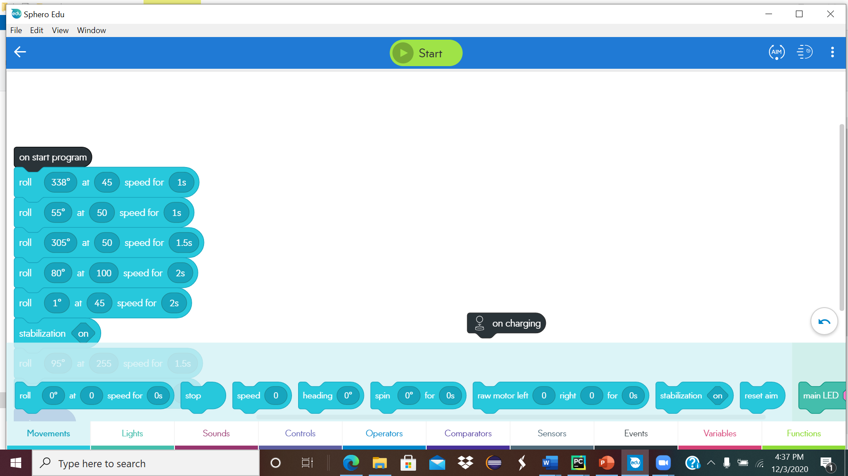
Block Code for Sprint 3 Agility

Slide 7
Robot Video
20201203_150628.mp4
Other attempts:
https://drive.google.com/file/d/17YNJVFc10hnUfauVY_FFqjaJ2Ck94fox/view?usp=sharing

